Slide 1

Predicting the Price of Next Day Cryptocurrencies: By using AI Models
Presented by: Afsaneh Zahmatkesh, Mohammed , Matiasvelastegui, Soumya, Zhen
Notes:
AI-generated content may be incorrect. --- This presentation will explore the intricate world of cryptocurrency price prediction. We will delve into various techniques, including fundamental and technical analysis, machine learning, and sentiment analysis, while also addressing the challenges and ethical considerations in this rapidly evolving market.

Slide 2
Agenda of Topics
Business Use Case for Crypto Currency
Data Cleansing and Feature Engineering
Machine Learning and Predictive Models:
Risks and Ethical Considerations
Notes:
We will begin with an introduction to cryptocurrencies, covering their definition, history, and key price influencers. Next, we'll discuss fundamental and technical analysis methods, followed by machine learning techniques. Additionally, we'll explore data cleansing, sentiment analysis, and finally, the risks associated with cryptocurrency trading.

Slide 3
Business Use Case : Crypto Currency Predicter for next day value
Notes:
Understanding the fundamentals of cryptocurrencies is essential for price prediction. This section will provide an overview of what cryptocurrencies are and their place in the financial world.

Slide 4

Crypto Currency Predicter for next day value- Overview:
Digital Currencies
To give you a brief Cryptocurrencies are digital or virtual currencies, providing a modern alternative to traditional money and payment systems.
For our use case, develop a model to predict the next-day closing price of a selected cryptocurrency (e.g., Bitcoin or Ethereum) using its historical daily market data.
Full disclosure the datasets that we are using to predict out model do not include Sentiment Analysis and Social Media Impact like for example: (Political Views, Stock market, Economy).
Notes:
Cryptocurrencies are digital or virtual currencies that use cryptography for security. They operate on decentralized networks based on blockchain technology, allowing for peer-to-peer transactions without intermediaries.

Slide 5
Data Cleansing and Feature Engineering
Notes:
Ensuring high-quality data is vital for accurate predictions. This section will discuss the importance of data cleansing and feature engineering in building effective predictive models.

Slide 6

Techniques for Data Cleansing
**Data Cleansing:** The data cleansing steps in this notebook are crucial for ensuring the reliability and quality of the cryptocurrency dataset.
The process begins by removing rows with no meaningful trading activity, specifically those where all price and volume fields are zero, which helps eliminate noise and irrelevant records. Further, rows with zero market capitalization but valid prices are excluded, as these likely indicate missing supply data and could distort analysis.
The notebook also flags and tracks records with zero trading volume despite valid prices, providing transparency for potential anomalies. Additionally, the dataset is filtered to include only records from December 27, 2013 onward, ensuring consistent volume data availability. These steps collectively help produce a cleaner, more accurate dataset, reducing the risk of misleading results in subsequent modeling.
Notes:
Data cleansing involves removing inaccuracies and inconsistencies in data. Techniques such as normalization, deduplication, and outlier detection are essential for preparing data for analysis.

Slide 7

Feature Engineering for Time Series Data
Feature engineering transforms the raw data into a richer set of predictors that enhance model performance and interpretability. In this notebook, several new features are created to capture price dynamics and trends:
- **Daily Spread:** Difference between high and low prices for each day. - **Daily Return:** Percentage change from open to close price. - **Moving Averages:** 3-day, 7-day, and 14-day moving averages of the close price to capture short- and medium-term trends. - **Volatility:** 7-day rolling standard deviation of the close price to measure price fluctuations. - **Lagged Features:** Previous day's close and volume to provide temporal context for predictions. - **Market Capitalization Rank:** Relative ranking of each coin by market capitalization for each date. - **Target Variable:** Next day's close price, used as the prediction target for modeling. By constructing these features, the dataset becomes more informative, enabling machine learning models to better capture patterns and relationships in cryptocurrency price movements.
Notes:
Feature engineering involves creating new input features from existing data to improve model performance. For time series data, techniques such as lag features and rolling statistics can be beneficial.

Slide 8
Machine Learning and Predictive Models that we used:
Notes:
Machine learning is becoming increasingly popular for predicting cryptocurrency prices. This section will introduce various models and their applications in finance.

Slide 9

Popular Models (Linear Regression, LSTM, Random Forest)
Linear Regression
Linear regression is a foundational machine learning model used to predict outcomes based on the linear relationship between variables, making it useful for price prediction.
LSTM Networks
Long Short-Term Memory (LSTM) networks are a type of recurrent neural network ideal for sequence prediction, making them effective for analyzing time series data like cryptocurrency prices.
Random Forest
Random Forest is an ensemble learning method that combines multiple decision trees to improve accuracy and robustness in predictions, suitable for complex datasets like cryptocurrency prices.
Notes:
Several machine learning models, such as linear regression, Long Short-Term Memory (LSTM) networks, and Random Forests, have shown promise in predicting cryptocurrency prices. We will explore how each model works.

Slide 10
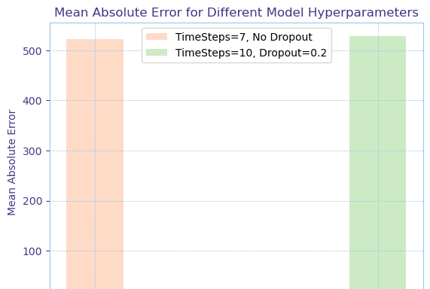
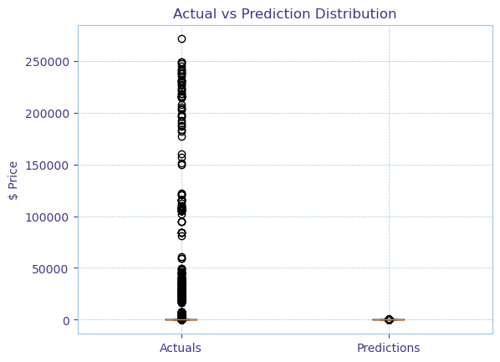
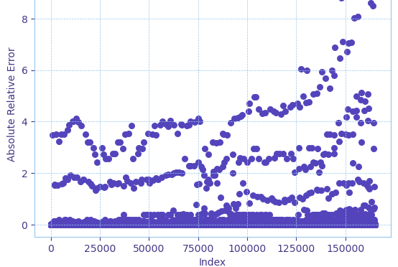
Gated Recurrent Unit (GRU) Networks Model
GRU is designed for sequential data, making them effective for capturing temporal patterns in stock/ cryptocurrency prices. GRU is a lighter alternative to LSTMs, with similar performance but fewer parameters and faster to train.
Notes:
While machine learning models can enhance price predictions, they also face challenges such as data quality, overfitting, and the ever-evolving nature of the cryptocurrency market.

Slide 11
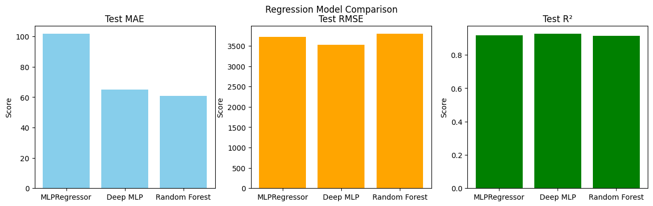
MLP Regression: Predictive Models
The MLP regression model was used on my side for continuous predictions: MLP Regression The first graph shows the metrics for this regression based models. ( MLP VS Random Forest).
Notes:
While machine learning models can enhance price predictions, they also face challenges such as data quality, overfitting, and the ever-evolving nature of the cryptocurrency market.

Slide 12
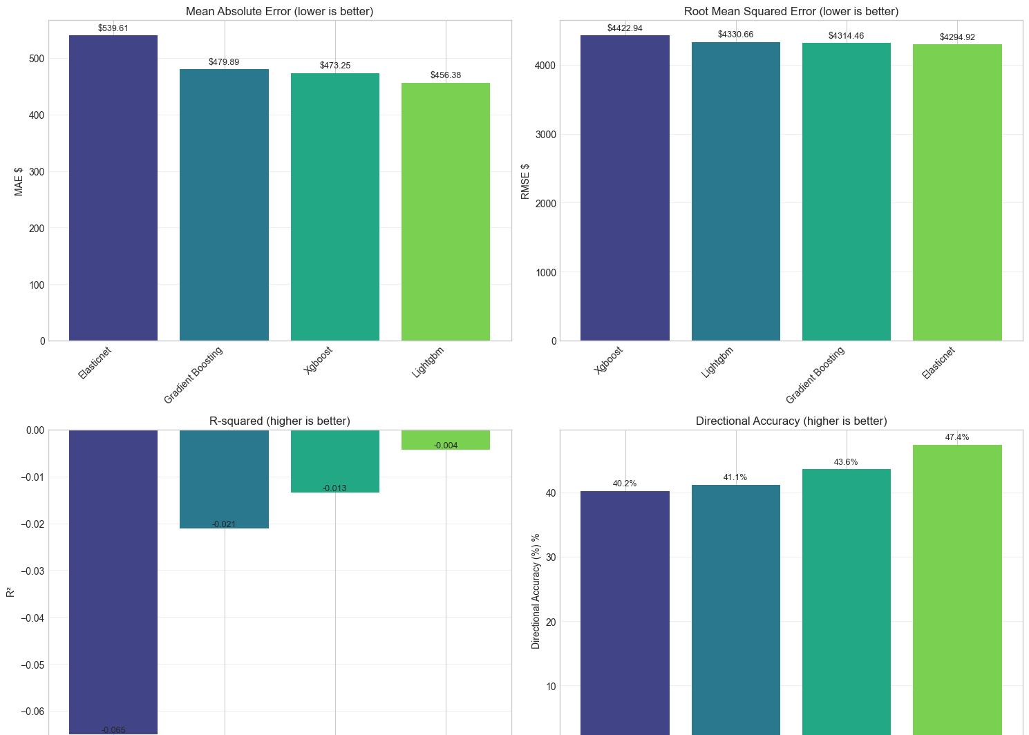
LightGBM XGBoost GradientBoost ElasticNet
Best Model among these is LightGBM with MAE: $ 456.3845 RMSE: $ 4,330.6633 R2: -0.0211 Accuracy: 40.20%
Notes:
While machine learning models can enhance price predictions, they also face challenges such as data quality, overfitting, and the ever-evolving nature of the cryptocurrency market.

Slide 13
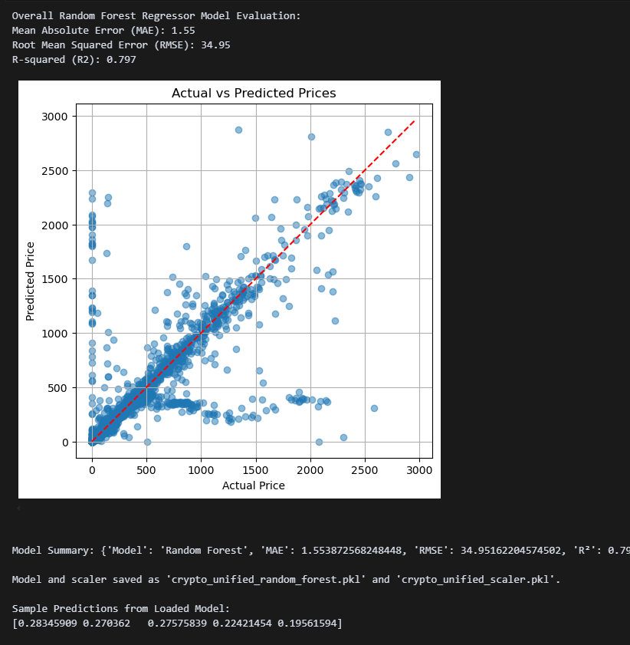
Linear Regression Model- Best Overall Model
Mean Absolute Error (MAE), Root Mean Squared Error (RMSE), and R-squared (R²). The trained model and scaler are saved for future use. - Feature Engineering:
Notes:
While machine learning models can enhance price predictions, they also face challenges such as data quality, overfitting, and the ever-evolving nature of the cryptocurrency market.

Slide 14
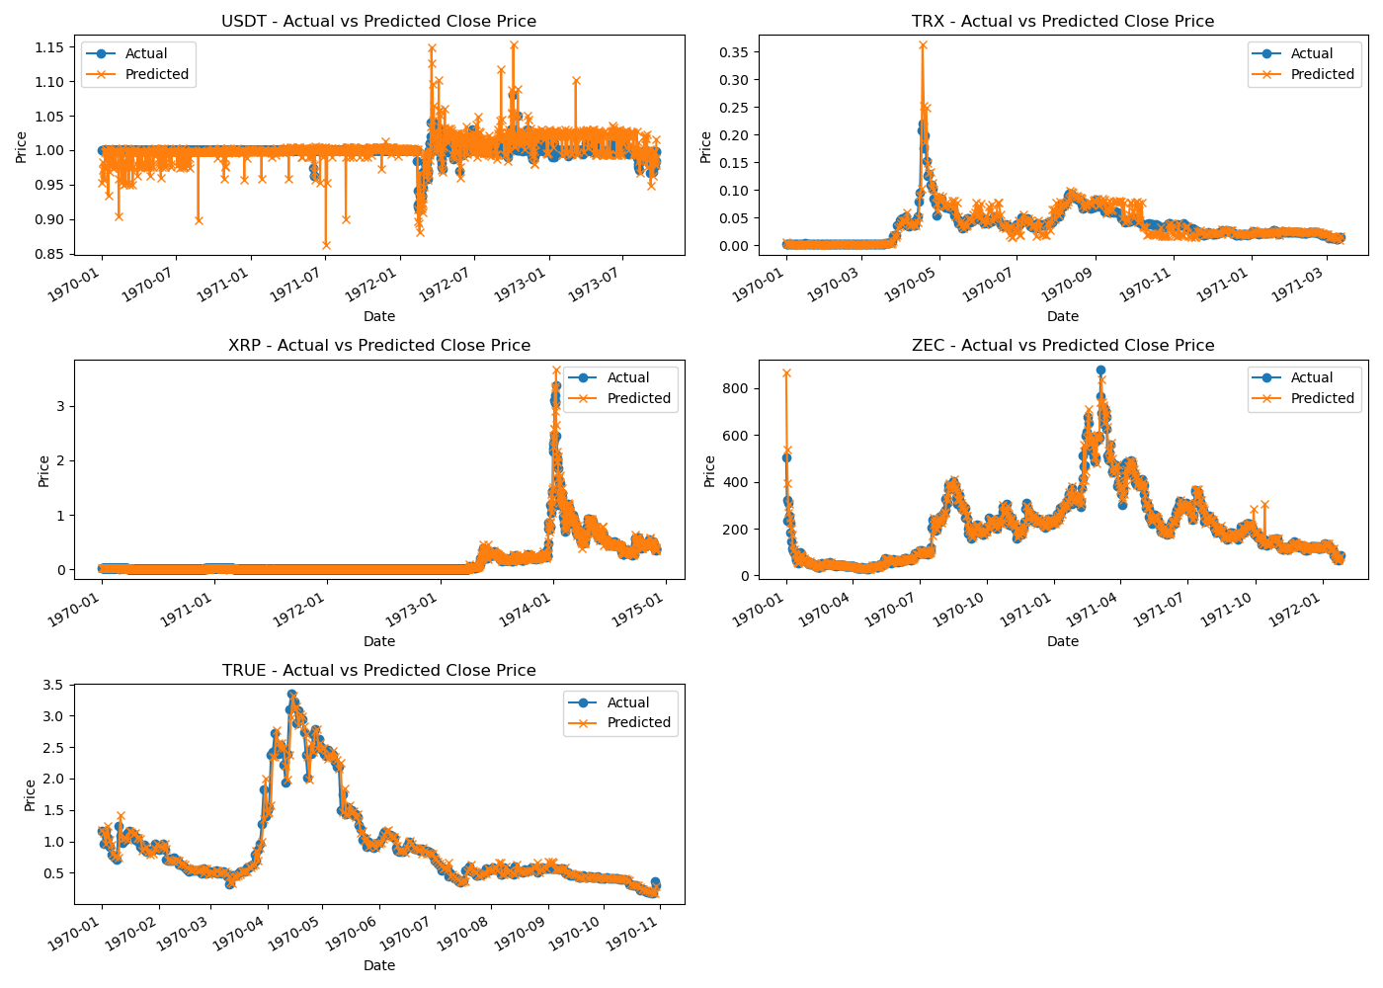
Random Forest Model
Here we trained a Random Forest Regressor model to predict the next-day closing prices of cryptocurrencies. Here's a summary of the results: Overall model performance:
Model Summary: {'Model': 'Random Forest', 'MAE': 1.553872568248448, 'RMSE': 34.95162204574502, 'R²': 0.7972844132714034}
Top 5 coins by average volume: ['USDT', 'TRX', 'XRP', 'ZEC', 'TRUE'] (present in the test set) Mean Absolute Error (MAE) per Top Coin:
USDT: MAE = 0.0113
TRX: MAE = 0.0072
XRP: MAE = 0.0136
ZEC: MAE = 13.6982
TRUE: MAE = 0.0725
Notes:
While machine learning models can enhance price predictions, they also face challenges such as data quality, overfitting, and the ever-evolving nature of the cryptocurrency market.

Slide 15

Challenges and Limitations of Predictive Models
Data Quality Issues
The accuracy of machine learning models heavily depends on the quality of the data used. We only received Cryptocurrency datasets from 2013 -2018 from Kaggle.
Not having Sentiment Analysis and Social Media Impact Datasets for example: (Political Views, Stock market, Economy). All these aspects needs to be taken to consideration with cryptocurrency. Which is while it is so volatile and unpredictable.
The limited time and computing power needed in order to create the Predictive Models for this use case.
Notes:
While machine learning models can enhance price predictions, they also face challenges such as data quality, overfitting, and the ever-evolving nature of the cryptocurrency market.

Slide 16
Risks and Ethical Considerations
Notes:
Understanding the risks and ethical implications of predicting cryptocurrency prices is crucial for responsible trading. This final section will address these important issues.

Slide 17

Market Manipulation and Regulatory Concerns
Risks of Market Manipulation
Market manipulation poses significant risks to traders in the cryptocurrency space, affecting market integrity and investor confidence. As the market is very volatile.
Protective Measures for Traders
Traders can implement various strategies to protect themselves from market manipulation, including due diligence and risk management.
Regulatory Landscape
Understanding the regulatory landscape surrounding market manipulation is essential for traders to navigate compliance and protect their investments.
Notes:
Market manipulation remains a significant risk in the cryptocurrency space. We will discuss how traders can protect themselves and the regulatory landscape surrounding these concerns.

Slide 18
Thanks for Listening! Any Questions?
Notes:
In conclusion, predicting cryptocurrency prices involves various techniques and approaches, each with its challenges. By understanding these methods and remaining aware of ethical considerations, traders can make informed decisions in this dynamic market.

